Slide 2
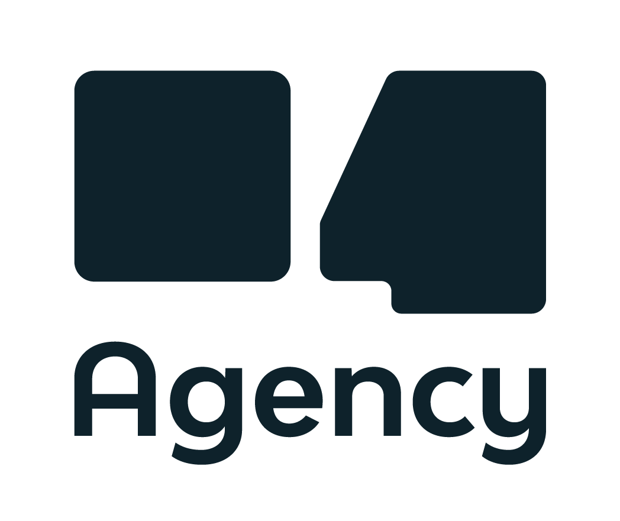
@agency04
@spotsie_io
@mihaelsedmak

Slide 4
2FA enabled fallback authentication (using Spring Security)
Agency04
@agency04
@spotsie_io
@mihaelsedmak

Slide 5
Notes:
Danas, najpopularnije tehnologije, platforme..dominiraju razgovorima, planovima, digitalnim transformacijama, migracijama u cloud..
Show of hands:
Tko radi na Javi 8
Tko je radio na javi starijoj od verzije 8
Tko je radio na javi starijoj od verzije 7
Tko je radio ili radi sa Oracle 10g
Tko je radio BIS aplikacije u Hrvatskoj

Slide 6
Notes:
From time to time, legacy systems (A.K.A. the stuff that successfully runs the enterprise business world :)) need a breath of fresh air. One such system, running healthcare processes for a big Croatian hospital was in need of a fresh new authentication module.

Slide 7
2FA (MFA)
An authentication method in which a user is granted access to a website or application only after successfully presenting two or more pieces of evidence (or factors) to an authentication mechanism:
knowledge (something only the user knows) - passwords, PINs...
possession (something only the user has) - X509 cards, USBs, authenticator apps on smartphones...
inherence (something only the user is) - biometric data...
Notes:
Multi-factor authentication (MFA; encompassing two-factor authentication, or 2FA, along with similar terms) is an electronic authentication method in which a user is granted access to a website or application only after successfully presenting two or more pieces of evidence (or factors) to an authentication mechanism: knowledge (something only the user knows), possession (something only the user has), and inherence (something only the user is). MFA protects user data—which may include personal identification or financial assets—from being accessed by an unauthorised third party that may have been able to discover, for example, a single password.

Slide 8
The stage...
Notes:
Oracle Forms 9i
Oracle DB 10g
Java < 8
No investment in new architectural modules / infrastructure
Low investment in new technologies
Moderate investment in new functionalities of the (still) current BIS
5 KBC, KB Dubrava, Varaždin, Sveti Duh - OB Zadar is a large hospital (almost), successfully running legacy software for their daily ops.
The current user/password auth module worked but had serio.., erm, some downsides. Also, the IT department did not want to introduce a full-fledged central auth solution (such as the fabulous Red Hat Keycloak), so we had to be creative. The request was simple - the primary auth method had to be 2FA (X509 on smartcards), and a fallback auth method had to be implemented (for the staff that does not have smartcards) - also 2FA enabled.

Slide 9
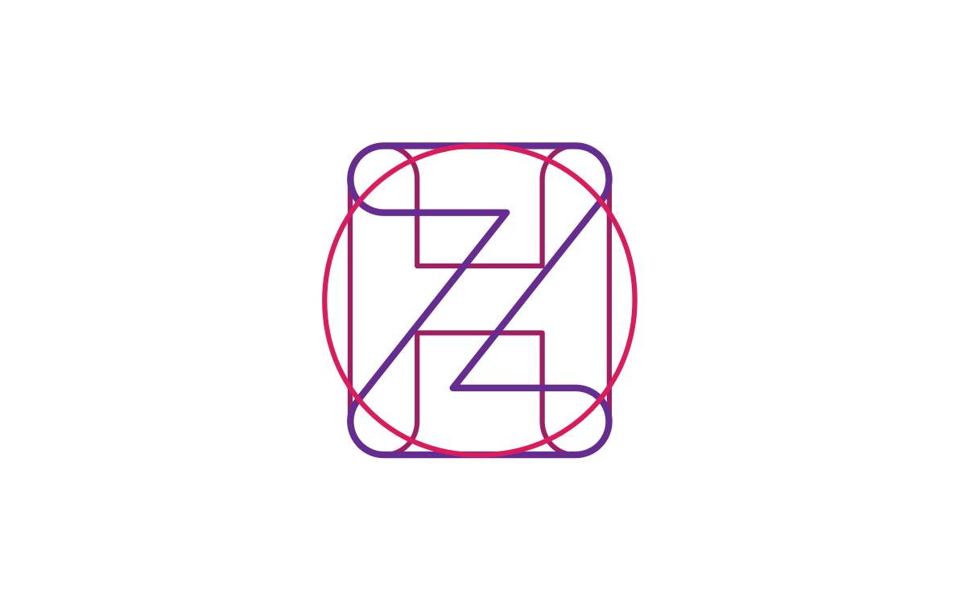
The NKOTB...
Notes:
Oracle Forms 9i
Oracle DB 10g
Java < 8
No investment in new architectural modules / infrastructure
Low investment in new technologies
Moderate investment in new functionalities of the (still) current BIS
5 KBC, KB Dubrava, Varaždin, Sveti Duh - OB Zadar is a large hospital (almost), successfully running legacy software for their daily ops.
The current user/password auth module worked but had serio.., erm, some downsides. Also, the IT department did not want to introduce a full-fledged central auth solution (such as the fabulous Red Hat Keycloak), so we had to be creative. The request was simple - the primary auth method had to be 2FA (X509 on smartcards), and a fallback auth method had to be implemented (for the staff that does not have smartcards) - also 2FA enabled.

Slide 10
Notes:
From time to time, legacy systems (A.K.A. the stuff that successfully runs the enterprise business world :)) need a breath of fresh air. One such system, running healthcare processes for a big Croatian hospital was in need of a fresh new authentication module.

Slide 11
Thank you!
@agency04
@spotsie_io
@mihaelsedmak

