Slide 1
9. međunarodna Java konferencija u Hrvatskoj
9th international Java conference in Croatia

Slide 2
Organizers
Notes:
Upravo traje JAXconf 2013

Slide 3
Dobrodošli! Welcome!

Slide 4
Some numbers
2 days
4 halls
40+ sessions
250 registered attendees
From more than 10 countries
And we all love Java ☺

Slide 5
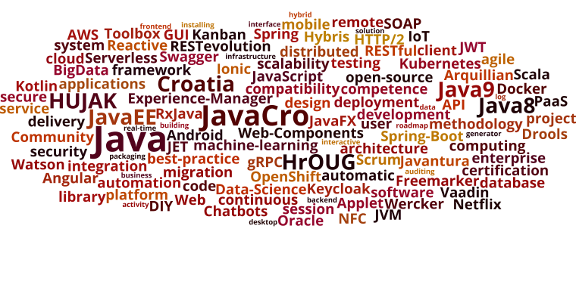
Contents

Slide 6
Info
General info at 2021.javacro.hr
On social networks you can use #JavaCro21
Latest agenda at 2021.javacro.hr/agenda
Lunch & Dinner (free drinks)
Monday Party
Boat every hour
Prizes and giveaways at the conference closing
Questionnaires at the end of each session
Notes:
Upravo traje JAXconf 2013

Slide 7
Halls
Four halls (map on the next slide)
Hall A – Large conference hall
Hall B – Club hall
Between reception and stairs to restaurant
Hall C – Restaurant hall
Level -1 (below Hall A, next to the restaurant)
Hall D –Conference Hall in Apartman’s building
Notes:
Upravo traje JAXconf 2013

Slide 8
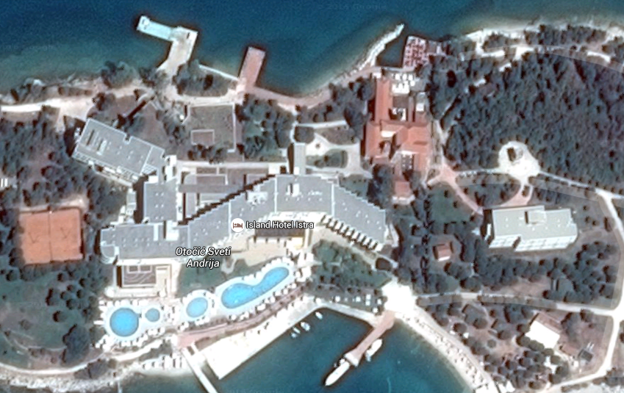
Halls
Party
Hall A & Hall C (-1)
Hall B
Hall D

Slide 9
Social
Sunday (hotel foyer and terrace)
DJ Nikša chillout
Welcome drink
Monday („castle”)
Gramaphonix
Boardgames corner
Teksas hold’em poker
Fire show
More drinks ☺
Notes:
Upravo traje JAXconf 2013

Slide 10
Sponsors

Slide 11
Uživajte! Enjoy!

